Slide 1


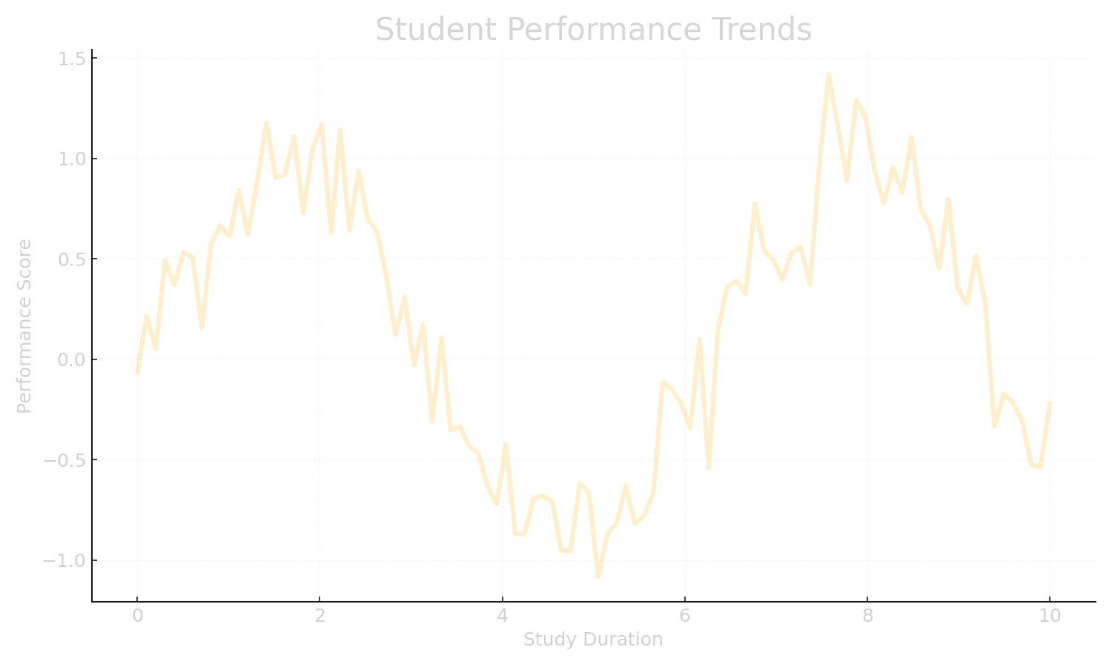


STUDENT ACADEMIC PERFORMANCE PREDICTION
USING IBM SPSS MODELER PREDICTIVE ANALYTICS PROJECT

Slide 2
INTRODUCTION
• EDUCATIONAL INSTITUTIONS GENERATE LARGE VOLUMES OF STUDENT DATA.
• PREDICTIVE ANALYTICS HELPS FORECAST ACADEMIC OUTCOMES.
• IBM SPSS MODELER ENABLES EFFECTIVE DATA MINING AND MODELING.
• PROJECT AIMS TO PREDICT FINAL STUDENT GRADES USING HISTORICAL
DATA.

Slide 3
PROJECT OVERVIEW
• PREDICT STUDENT ACADEMIC PERFORMANCE USING MACHINE LEARNING.
• UTILIZE DATASET CONTAINING DEMOGRAPHIC, BEHAVIORAL, AND ACADEMIC
ATTRIBUTES.
• BUILD AND COMPARE PREDICTIVE MODELS IN IBM SPSS MODELER.
• IDENTIFY INFLUENTIAL FACTORS AFFECTING ACADEMIC SUCCESS.

Slide 4
DATASET DESCRIPTION
• TOTAL RECORDS: 395 STUDENTS
• TOTAL ATTRIBUTES: 33
• CONTAINS DEMOGRAPHIC, FAMILY, LIFESTYLE, AND ACADEMIC
INFORMATION.
• TARGET VARIABLE: G3 – FINAL GRADE
• INCLUDES PAST GRADES (G1, G2), STUDY TIME, ABSENCES, ETC.

Slide 5
PROBLEM STATEMENT
• INSTITUTIONS STRUGGLE TO IDENTIFY ACADEMICALLY AT-RISK STUDENTS
EARLY.
• LACK OF DATA-DRIVEN DECISION-MAKING IN STUDENT EVALUATION.
• NEED PREDICTIVE SYSTEM TO SUPPORT TIMELY ACADEMIC INTERVENTION.

Slide 6
OBJECTIVES
• PREDICT STUDENT FINAL ACADEMIC PERFORMANCE ACCURATELY.
• ANALYZE FACTORS INFLUENCING ACADEMIC OUTCOMES.
• SUPPORT EDUCATORS IN PROACTIVE STUDENT GUIDANCE.
• IMPROVE INSTITUTIONAL ACADEMIC PLANNING AND RETENTION.

Slide 7
TOOLS & TECHNOLOGIES USED
• IBM SPSS MODELER
• DATA MINING & PREDICTIVE ANALYTICS
• STATISTICAL & MACHINE LEARNING ALGORITHMS
• MICROSOFT EXCEL (OPTIONAL FOR PREPROCESSING)

Slide 8
METHODOLOGY
1. DATA COLLECTION & UNDERSTANDING
2. DATA PREPROCESSING & CLEANING
3. EXPLORATORY DATA ANALYSIS
4. FEATURE SELECTION & TRANSFORMATION
5. MODEL BUILDING & TRAINING
6. MODEL EVALUATION & COMPARISON
7. PREDICTION & INTERPRETATION

Slide 9
PREDICTIVE MODELS APPLIED
• DECISION TREES (C&R TREE, CHAID)
• LINEAR/MULTIPLE REGRESSION
• LOGISTIC REGRESSION
• NEURAL NETWORKS
• RANDOM FOREST (IF IMPLEMENTED)

Slide 10
KEY FINDINGS
• PREVIOUS GRADES (G1, G2) STRONGLY PREDICT FINAL GRADE.
• STUDY TIME POSITIVELY IMPACTS PERFORMANCE.
• ABSENCES AND ALCOHOL CONSUMPTION NEGATIVELY AFFECT RESULTS.
• FAMILY AND SCHOOL SUPPORT IMPROVE ACADEMIC OUTCOMES.

Slide 11
FEASIBILITY STUDY
• TECHNICALLY FEASIBLE WITH SPSS MODELER.
• COST-EFFECTIVE AND OPERATIONALLY PRACTICAL.
• ETHICALLY SAFE—DATASET CONTAINS NO PERSONAL IDENTIFIERS.
• CAN BE COMPLETED WITHIN ACADEMIC PROJECT TIMELINE.

Slide 12
FUTURE SCOPE
• INCLUDE MORE LEARNING BEHAVIOR AND PSYCHOLOGICAL FACTORS.
• DEPLOY AS A WEB OR MOBILE DASHBOARD.
• INTEGRATE REAL-TIME ACADEMIC MONITORING.
• USE ADVANCED ML MODELS LIKE XGBOOST OR DEEP LEARNING.

Slide 13
ACKNOWLEDGMENT
• IBM SPSS MODELER
• STUDENT PERFORMANCE DATASET
• ACADEMIC RESEARCH ON EDUCATIONAL DATA MINING

Slide 14
CONCLUSION
• PREDICTIVE ANALYTICS EFFECTIVELY FORECASTS STUDENT PERFORMANCE.
• HELPS INSTITUTIONS IDENTIFY AT-RISK STUDENTS EARLY.
• SUPPORTS DATA-DRIVEN EDUCATIONAL DECISIONS.
• DEMONSTRATES THE POTENTIAL OF SPSS MODELER IN ACADEMIC
ANALYTICS.

Slide 15
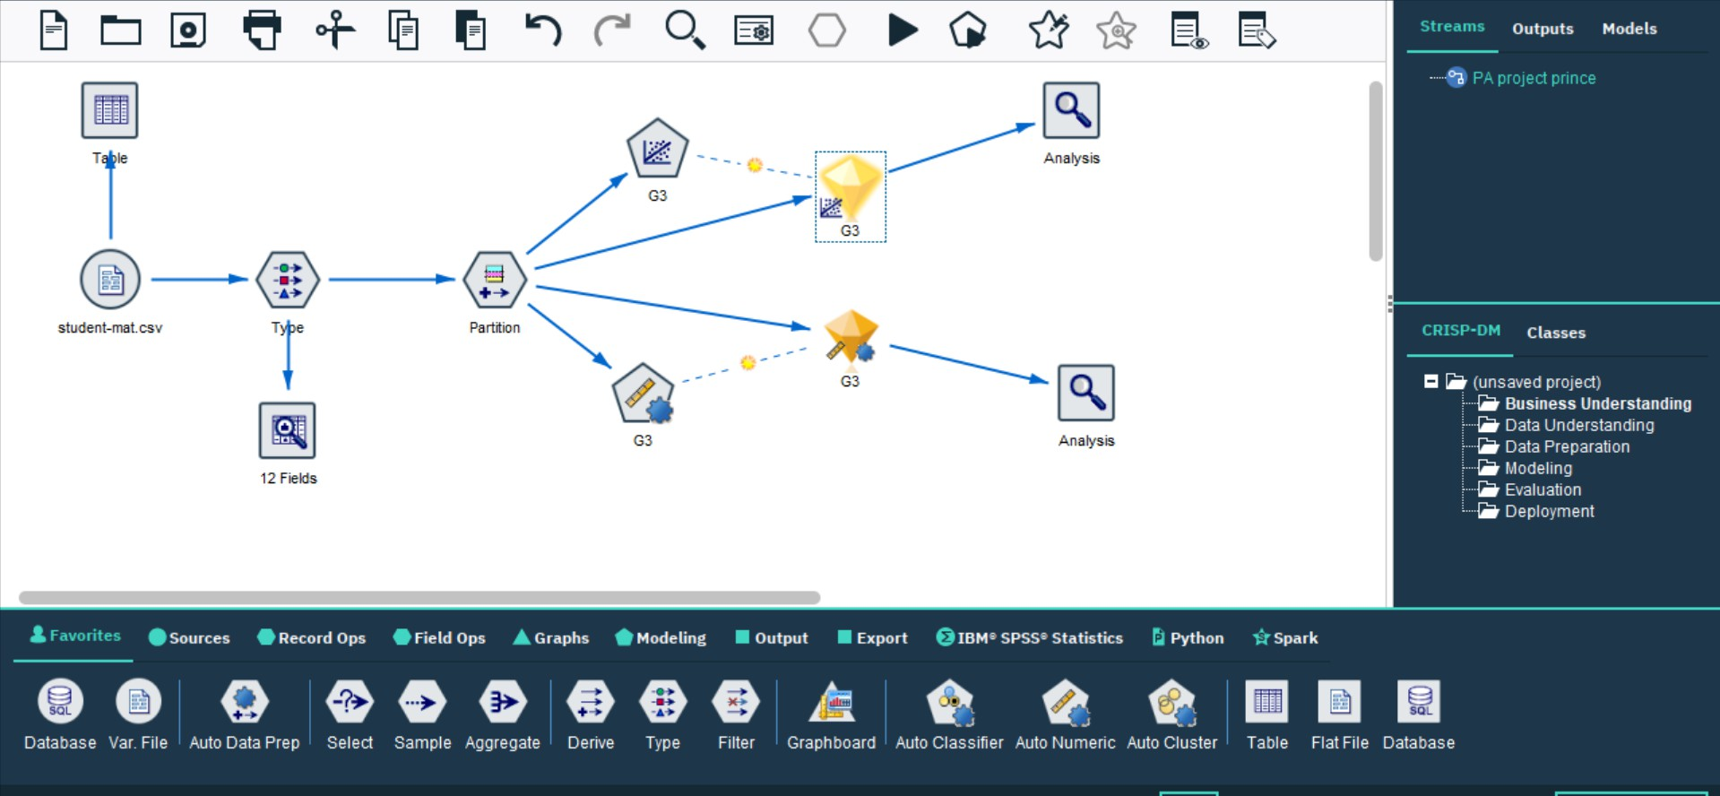
FINAL STREAM:

Slide 16
Thank You!

